Slide 1

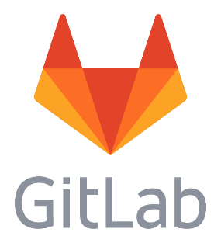
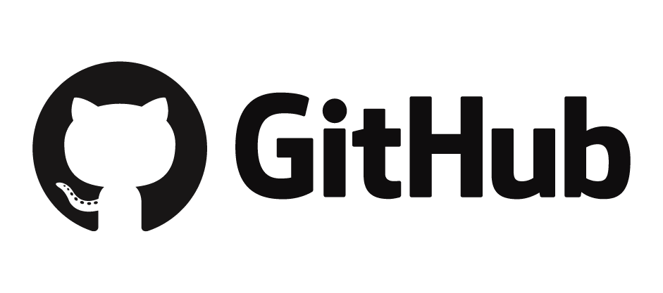
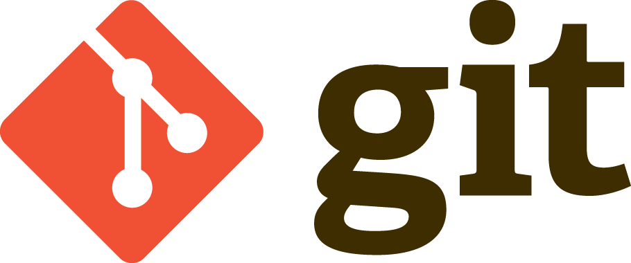
Op naar distributed revision control en source code management bij VODW
Version control and open source

Slide 2
Contents
What is version control?
What is Git?
Why Git, GitHub and GitLab?
Why open scource is important (for Data Science)
The Git workflow

Slide 3

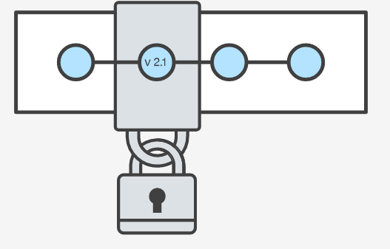
What is version control?
Version control systems are a category of software tools that help a software team manage changes to source code over time. Version control software keeps track of every modification to the code in a special kind of database. If a mistake is made, developers can turn back the clock and compare earlier versions of the code to help fix the mistake while minimizing disruption to all team members.
For almost all software projects, the source code is like the crown jewels - a precious asset whose value must be protected. Version control protects source code from both catastrophe and the casual degradation of human error and unintended consequences.
The primary benefits you should expect from version control are as follows:
A complete long-term change history of every file.
Branching and merging.
Traceability.
The question is not whether to use version control but which version control system to use.

Slide 4
What is Git?
By far, the most widely used modern version control system in the world today is Git. Git is a mature, actively maintained open source project originally developed in 2005 by Linus Torvalds, the famous creator of the Linux operating system kernel. Additionally it works well on a wide range of operating systems and IDEs (Integrated Development Environments).
Git is an example of a DVCS (Distributed Version Control System). Rather than have only one single place for the full version history of the software as is common in once-popular version control systems like CVS or Subversion (SVN), in Git, every developer's working copy of the code is also a repository that can contain the full history of all changes.
In addition to being distributed, Git has been designed with performance, security and flexibility in mind.
Git is the most widley used and modern distributed version control system in the world today.

Slide 5

Git, Github and GitLab?

Slide 6
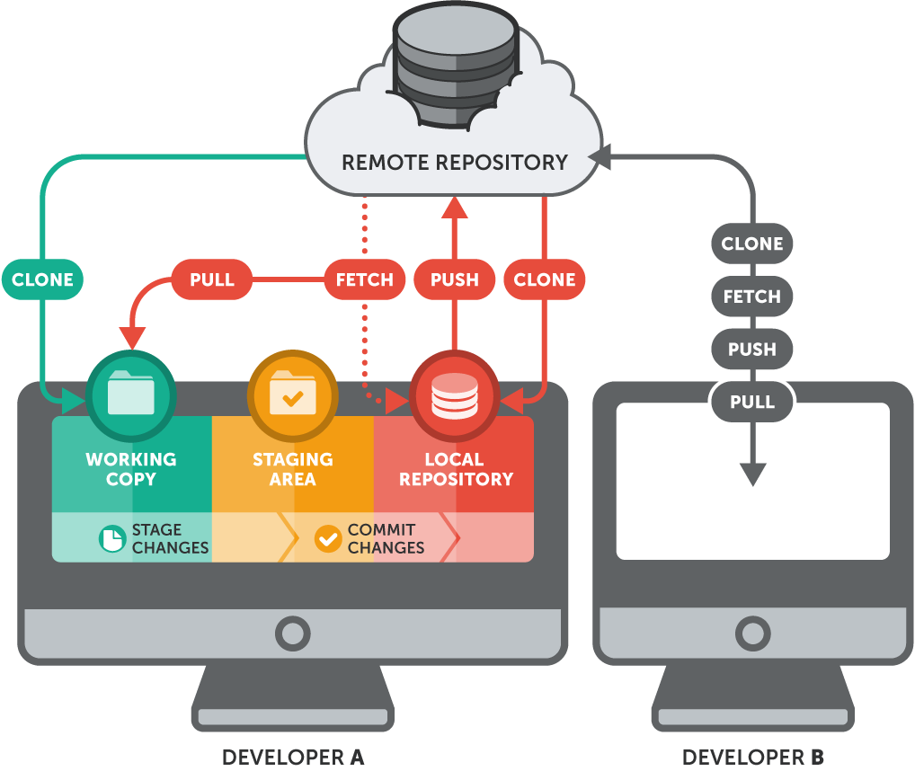

Slide 7
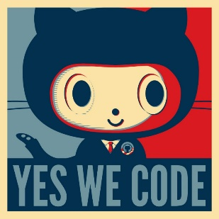
Why should we invest in the Git workflow ?
Git makes necessary version control efficient and effective.
Git has the functionality, performance, security and flexibility
Git is undoubtedly the successor to the previous generations of successful open source version control systems, SVN and CVS
Why GitHub for Open Source?
“Github is like Facebook for programmers. Everyone’s on there. You can look at what they’re working on and easily peruse their code and make suggestions or changes.”
Why GitLab for projects that are not open?
GitLab is unlike GitHub free for private repositories. It works the same as GitHub and in case we chose to use GitHub for all our work it is easy to migrate.
GitHub is de meest effectieve tool voor peer coding

Slide 8
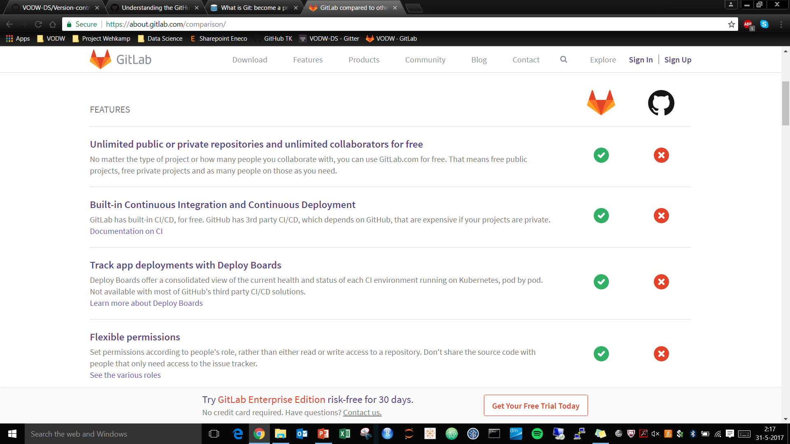
GitLab is free, also for private repositories.

Slide 9
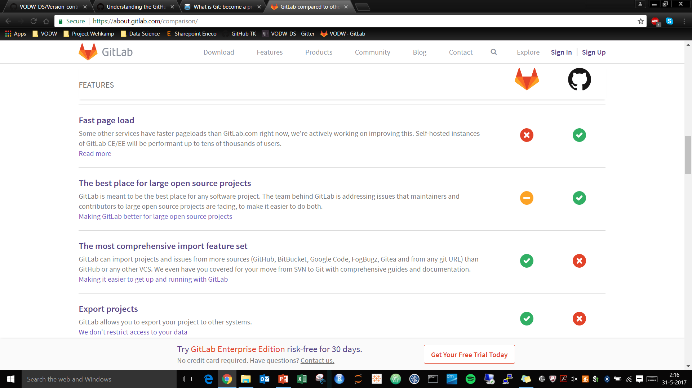
GitHub for Open Source, GitLab gives the honest answer.

Slide 10
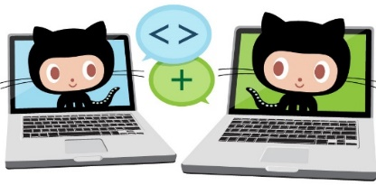
What are GitHub and GitLab?
GitHub (freemium) and GitLab (open-source) are web-based platforms for o.a. version control based on a famous source code management system (Git). Next to a command-line tool, like Git, GitHub and GitLab add their own features like a graphical interface and integration with other tools like Trello.
The platforms make it possible to work together on mainly code from different locations. For this “branches” from the remote repository are used.
Repositories can contain all sorts of files. Next code from all sort of languages, for example data files and graphical files can be part of your repository.
GitHub en GitLab are among the most popular web-based repository hosting services.

Slide 11
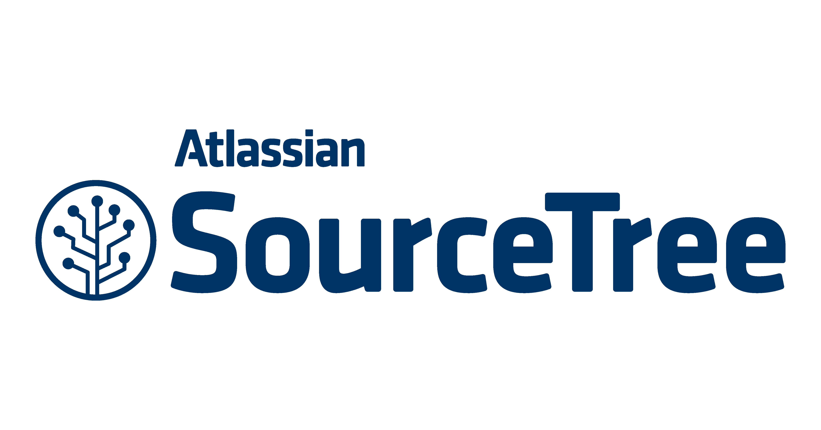

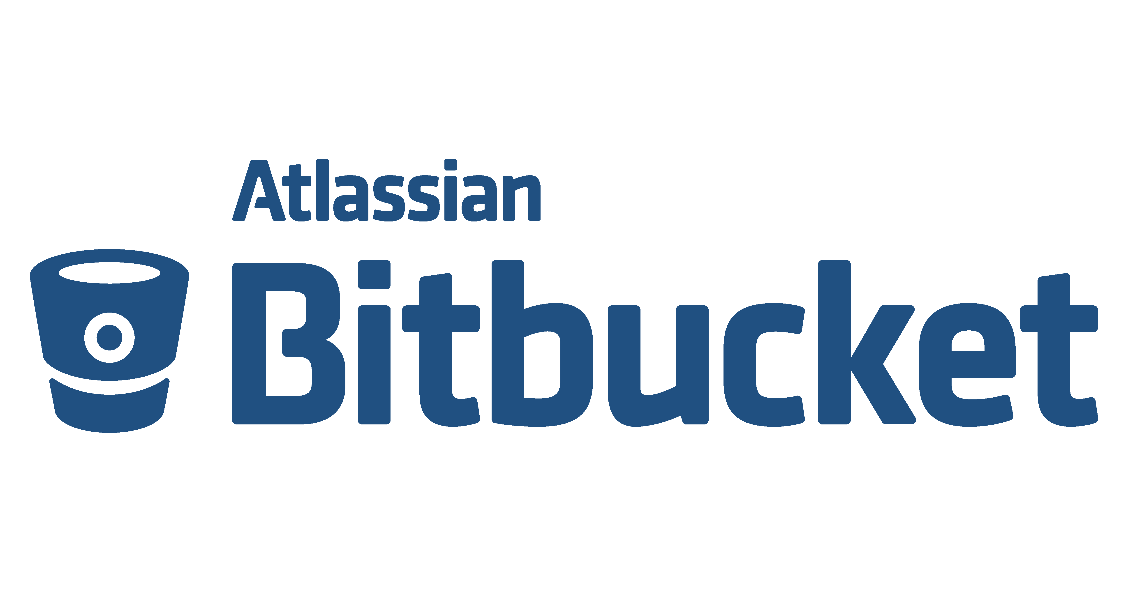

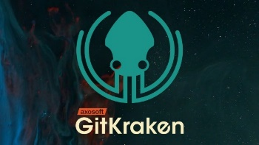



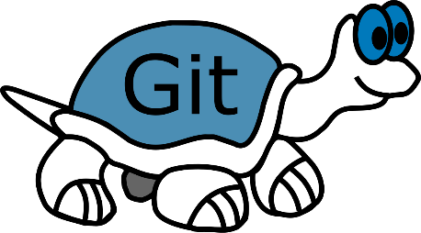
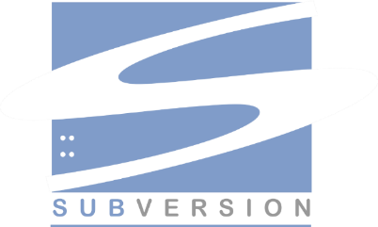


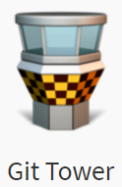


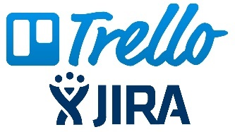
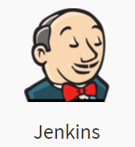

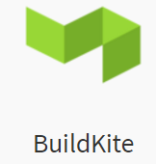

(Distributed) version control system
Web-based repository hosting service
Client
Chat and collaboration tools
Project management
Testing

Slide 12

Why open source is important (for Data Science).

Slide 13
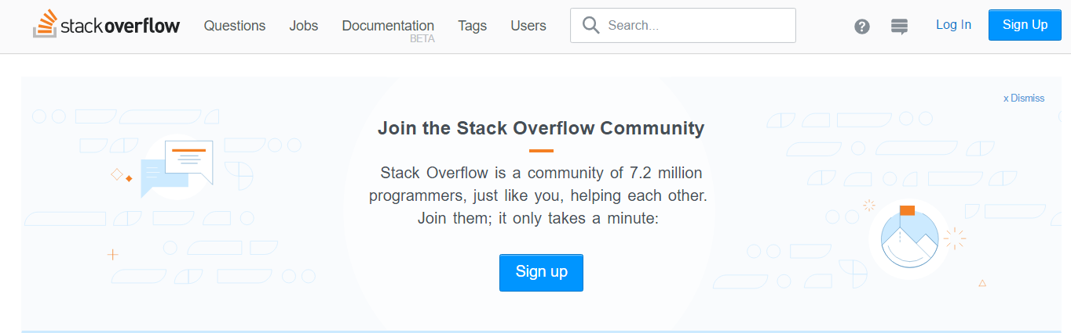
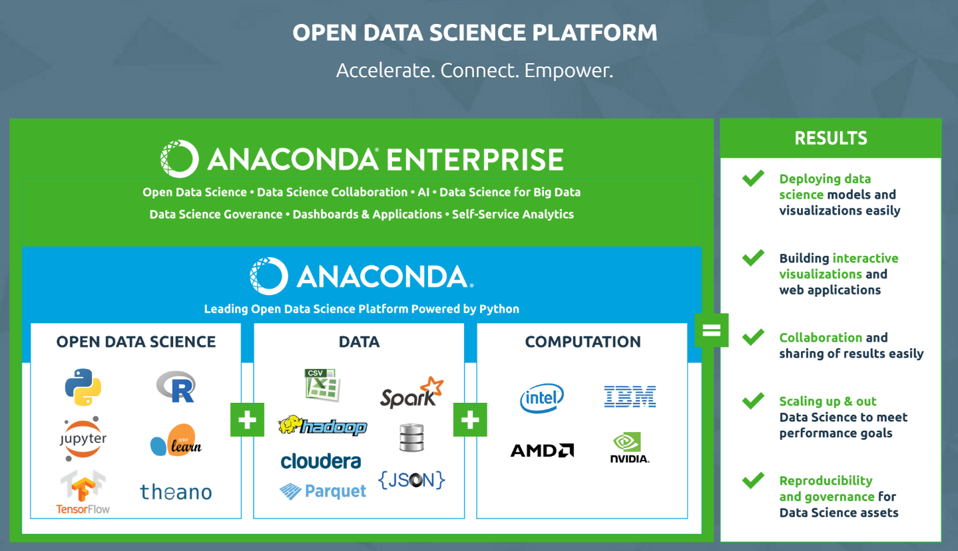
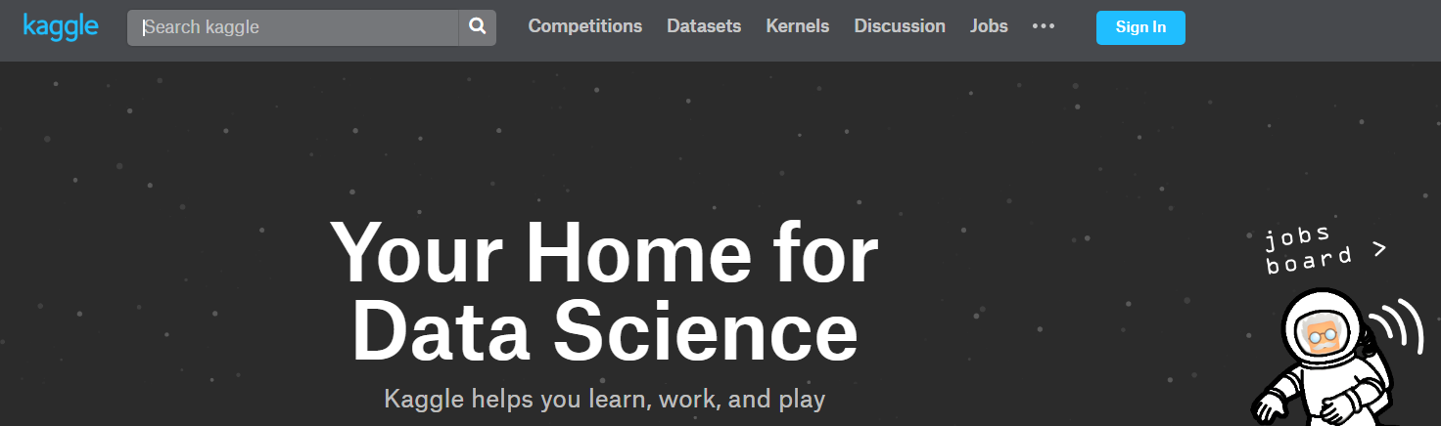
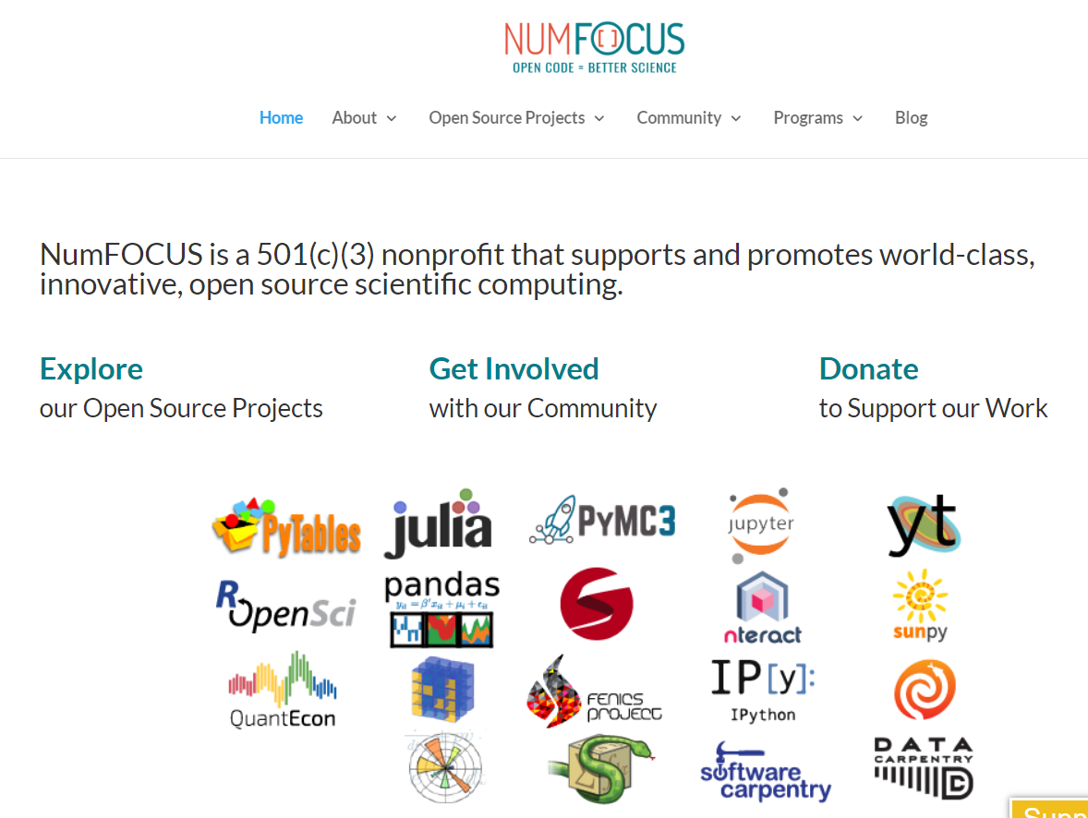
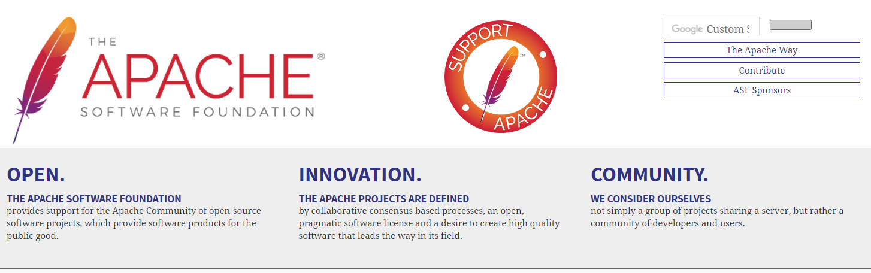
Open Source

Slide 14
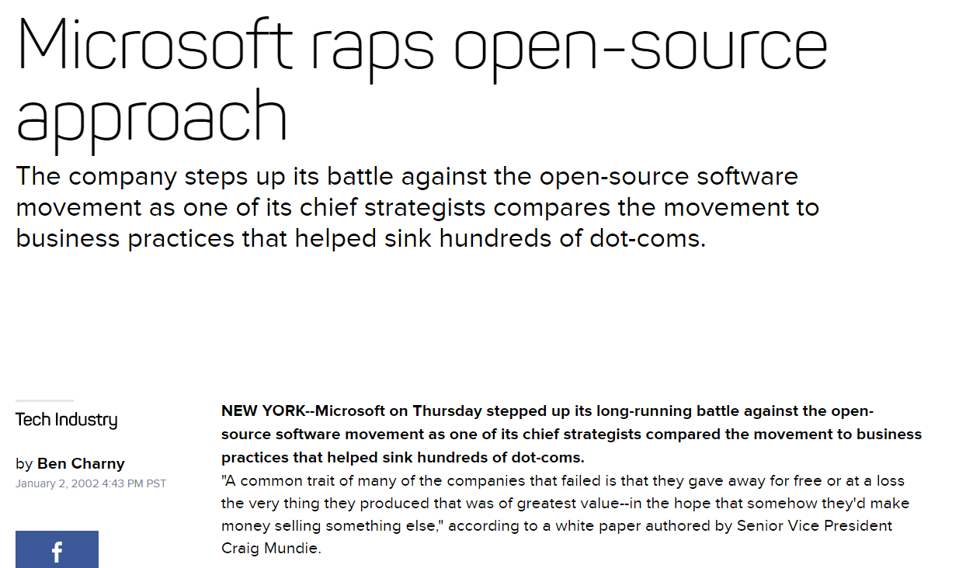

Slide 15

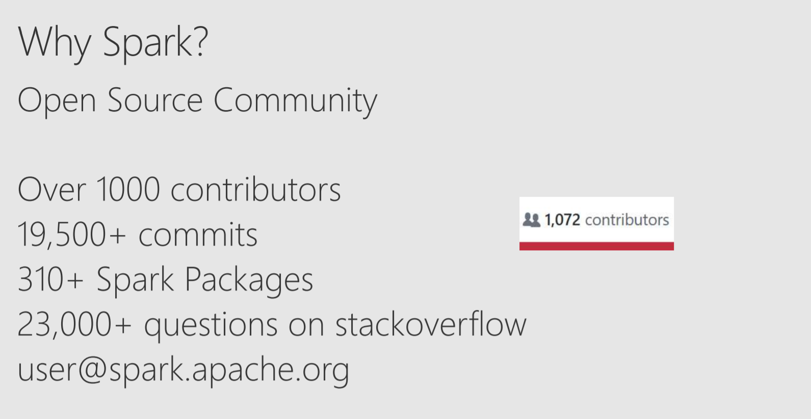
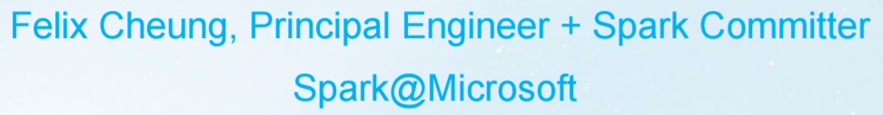

Slide 16
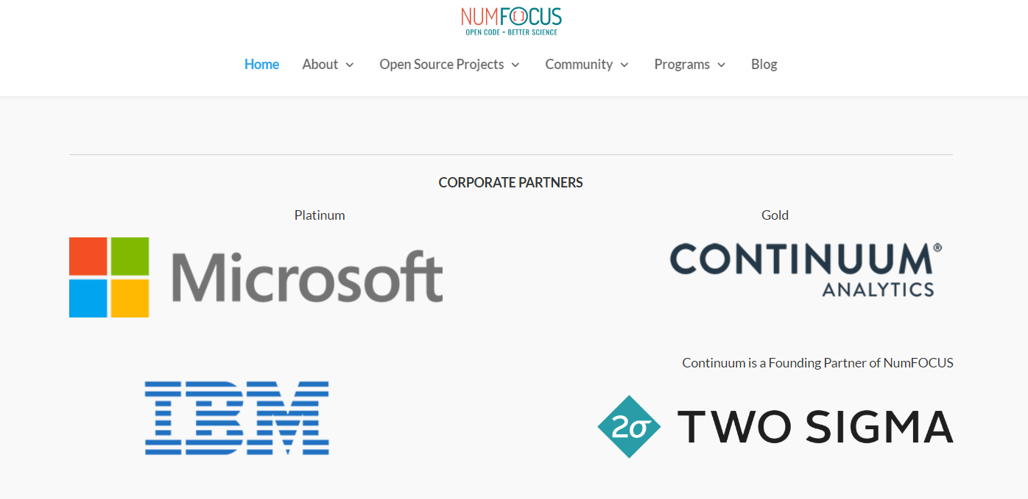

Slide 17
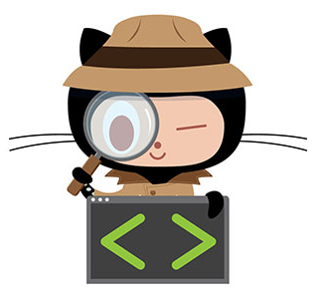
Most important Git actions?
Branching
When you create a branch in your project, you're creating an environment where you can try out new ideas. Changes you make on a branch don't affect the master branch
Committing
This process of adding commits keeps track of your progress as you work on a feature branch. Commits also create a transparent history of your work that others can follow to understand what you've done and why. Each commit has an associated commit message
Pull requests
Pull Requests initiate discussion about your commits. Because they're tightly integrated with the underlying Git repository, anyone can see exactly what changes would be merged if they accept your request.
Learning to use the power of Git can take some time, however once learned, that power can be used to increase development speed.

Slide 18
Most important Git actions?
Code review
During code review, the person or team reviewing your changes may have questions or comments. This may lead to adjustments to the branch you want to merge.
Deploying
Once your pull request has been reviewed and the branch passes your tests, you can deploy your changes to verify them in production.
Merging
Now that your changes have been verified in production, it is time to merge your code into the master branch. Once merged, Pull Requests preserve a record of the historical changes to your code. Because they're searchable, they let anyone go back in time to understand why and how a decision was made.
Have a look here for more
Learning to use the power of Git can take some time, however once learned, that power can be used to increase development speed.

